Slide 1
Top-5-European-Leagues-Analysis
Seasons
2017-2018 2018-2019 2019-2020
Created by Hany Sedarous
fbref.com

Slide 2





Top 5 Leagues In Europe

Slide 3
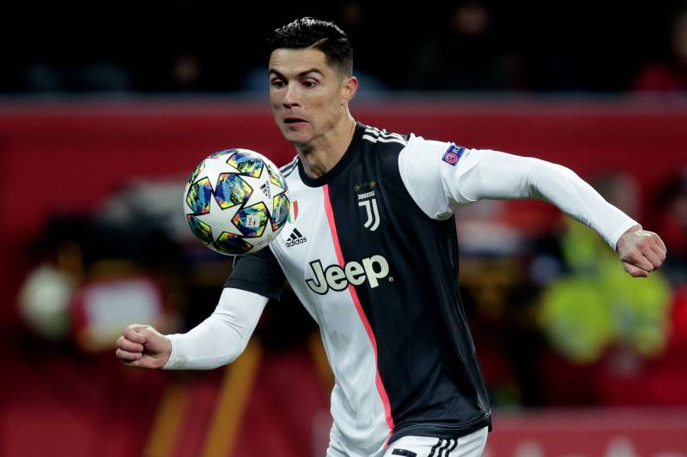

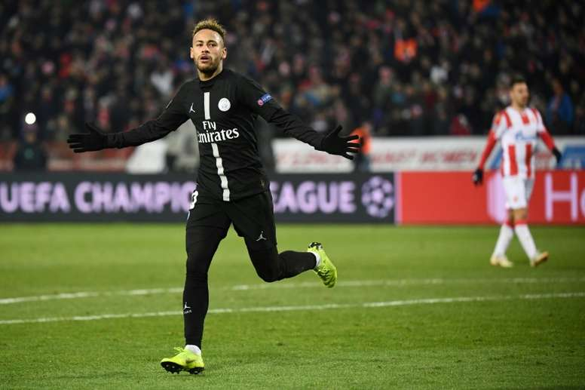




What Is The Best League In Europe?
Who Is The Best Team In Europe?
Who Are The League Champions?
Who Are The Top 5 Strikers In Europe?
What Is The Players Age Categorization?
Who Are The Top 10 Toughest Players?
Let’s find out…

Slide 4
Some hints before we start
Top 5 leagues were determined based on (sportytell.com).
All data were collected from (fbref.com).
Due to COVID 19, We couldn’t get more analysis for 2019-2020 season.
Now let’s get some answers

Slide 5
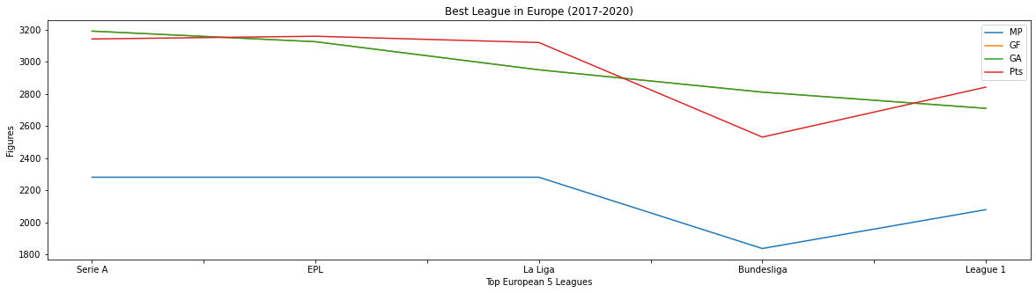
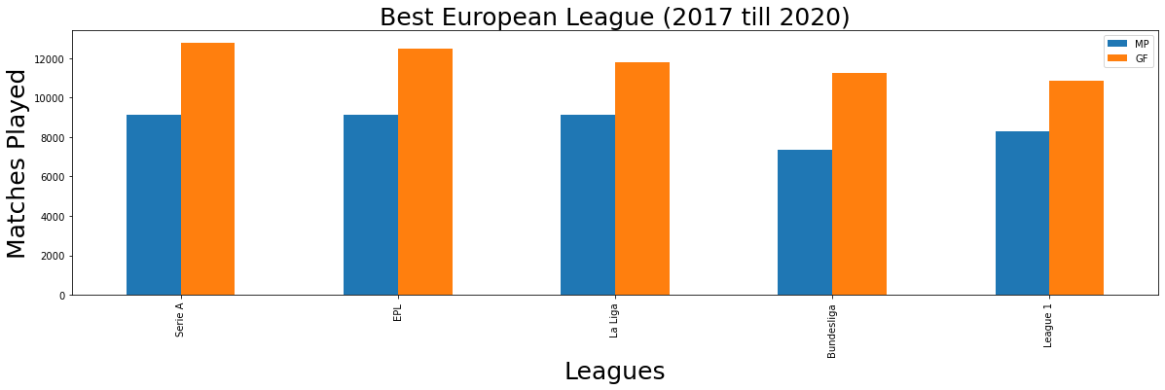
What Is the Best League In Europe?
Based on the number of played games, goals and total points…
Italian League Serie A is the best league in Europe

Slide 6
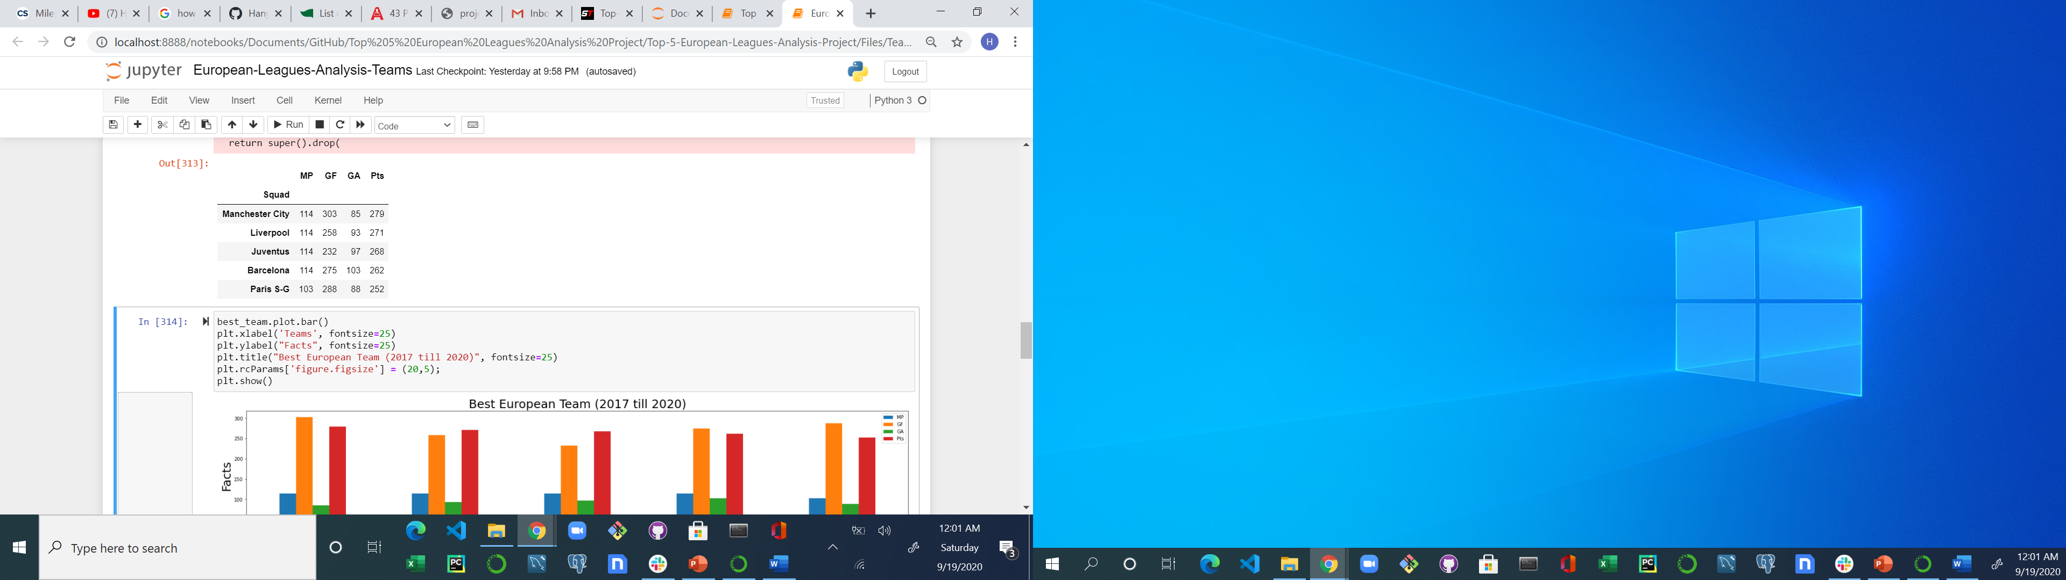
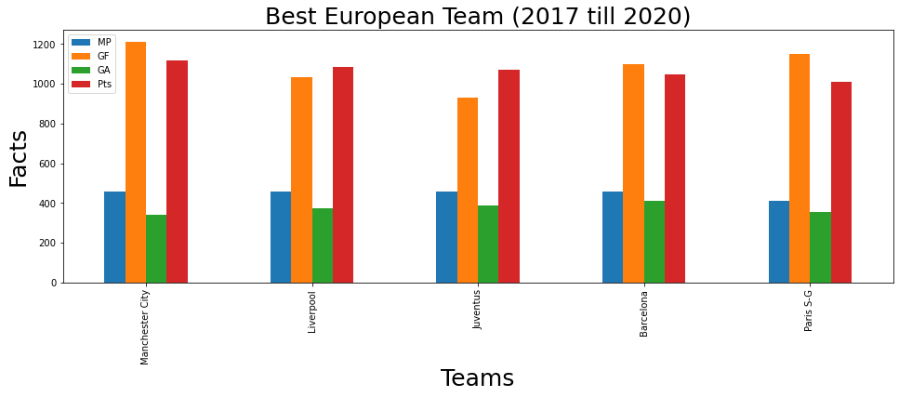
Who Is The Best Team In Europe?
Based on the number of played games, goals and total points…
Manchester City is the best team in Europe

Slide 7
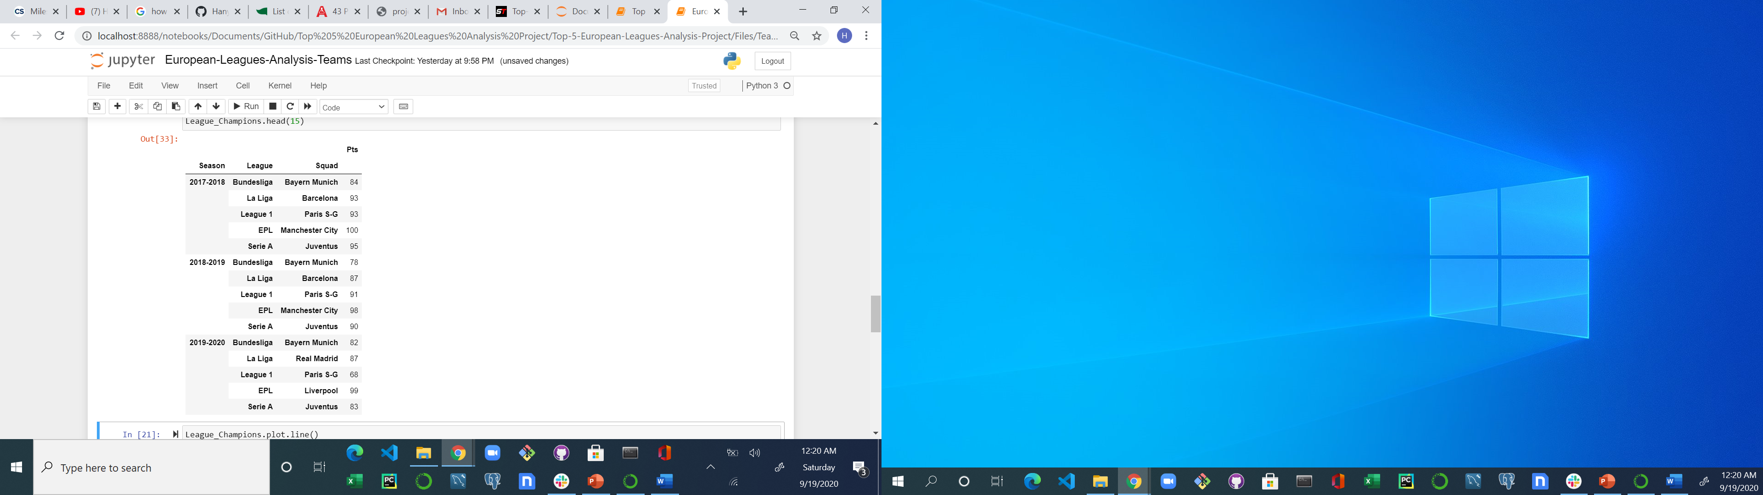
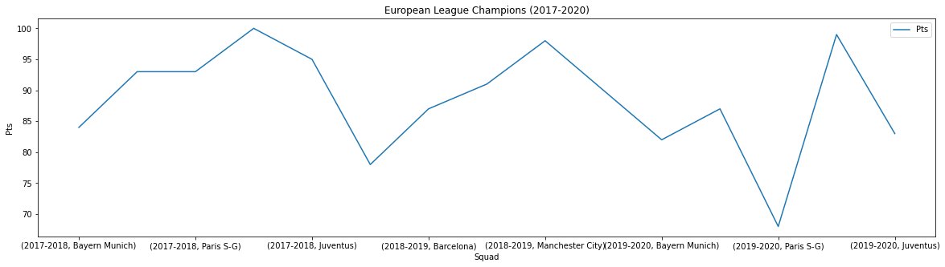
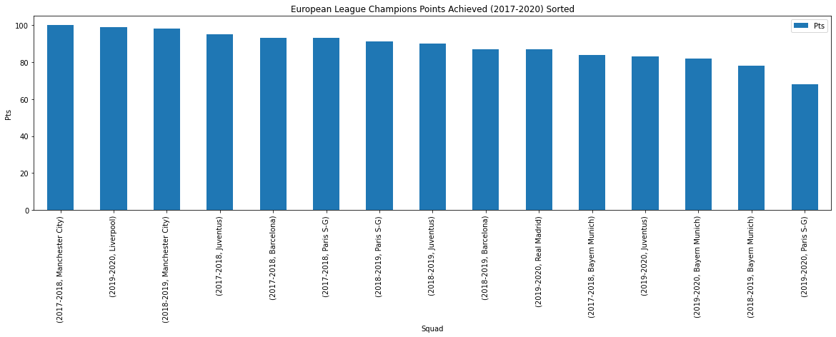
Who Are The League Champions?
Results were generated based on the teams who got the maximum points of each league

Slide 8

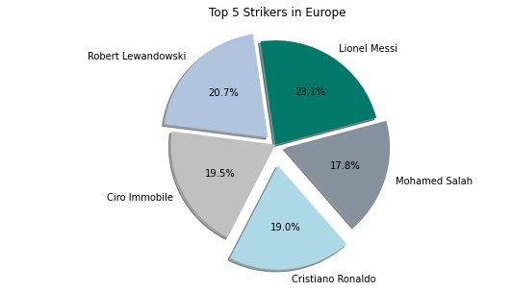
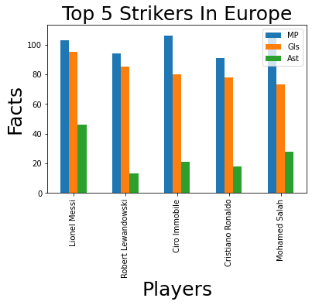
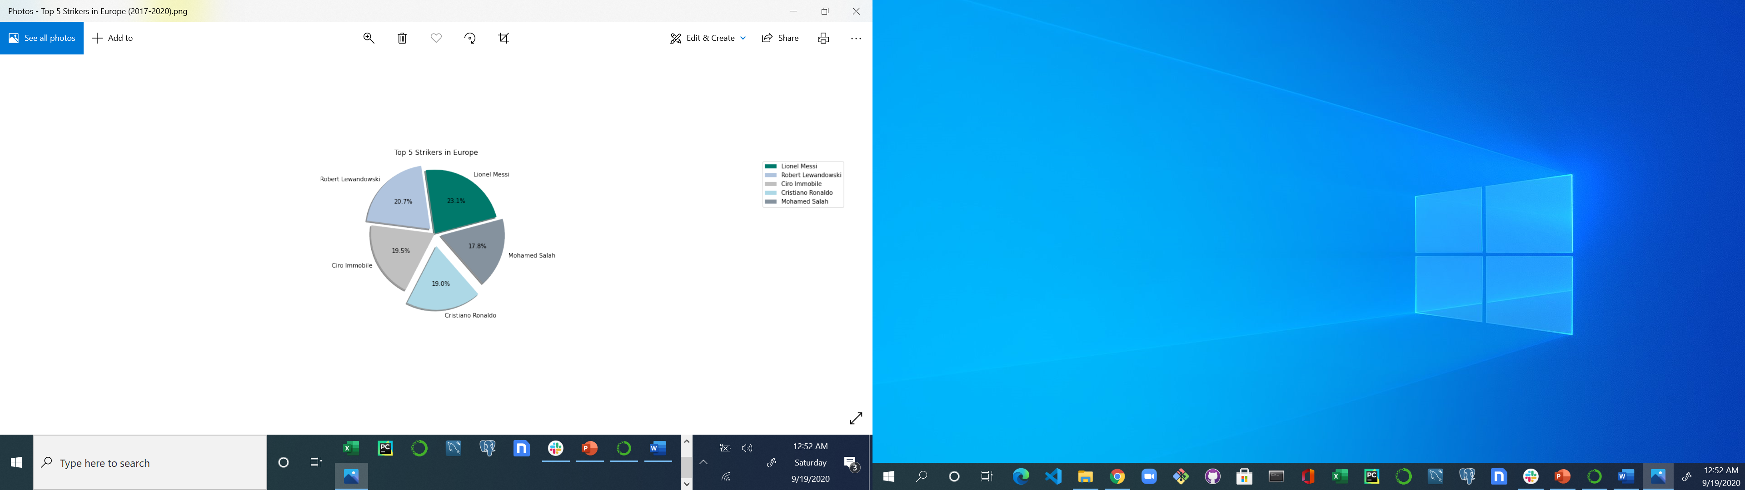
Who Are The Top 5 Strikers In Europe?
In addition and based on the comparison of the top 5 strikers scored goals…
Lionel Messi is the best striker in Europe

Slide 9
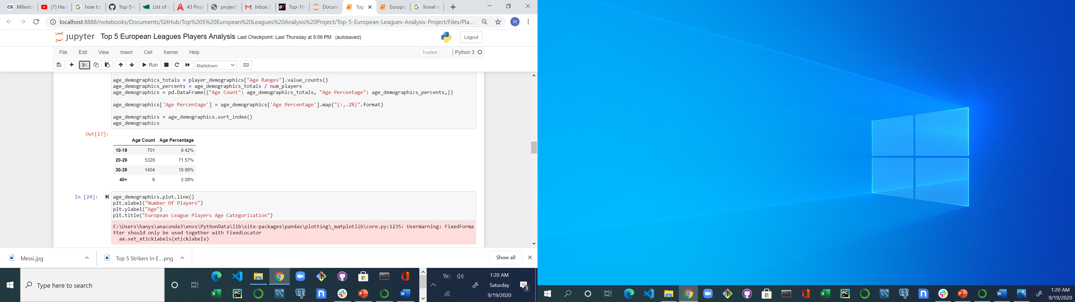
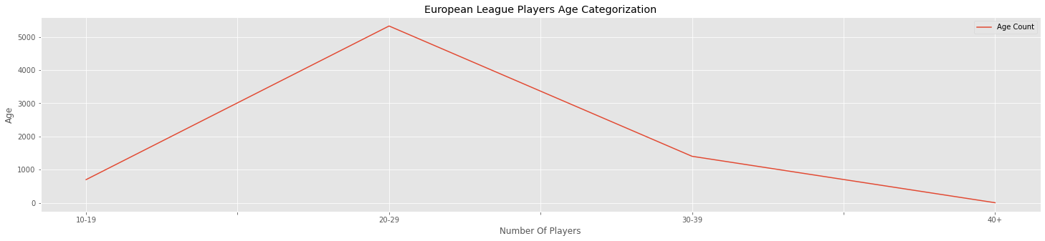
What Is The Players Age Categorization?
Analysis showed that most of players age falls between
20 to 29 years old…

Slide 10
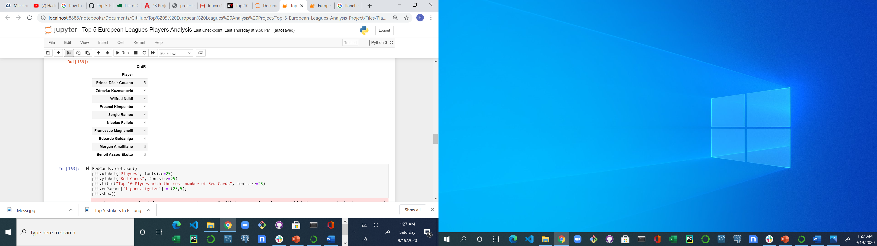
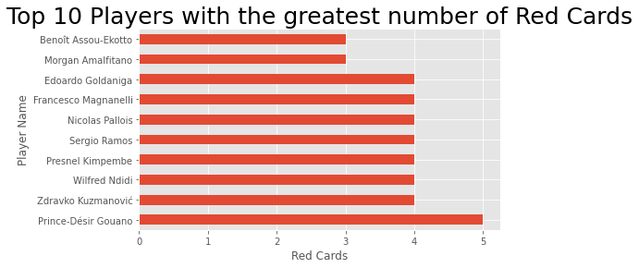
Who Are The Top 10 Toughest Players?
In addition and based on the number red cards…
Prince-Désir Gouano is the toughest player in Europe

Slide 11
Thank You
Hany Sedarous

